Slide 1


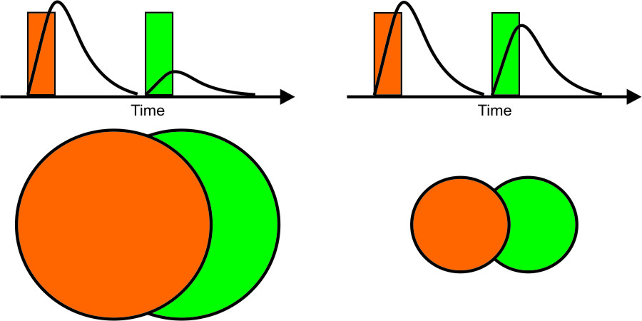
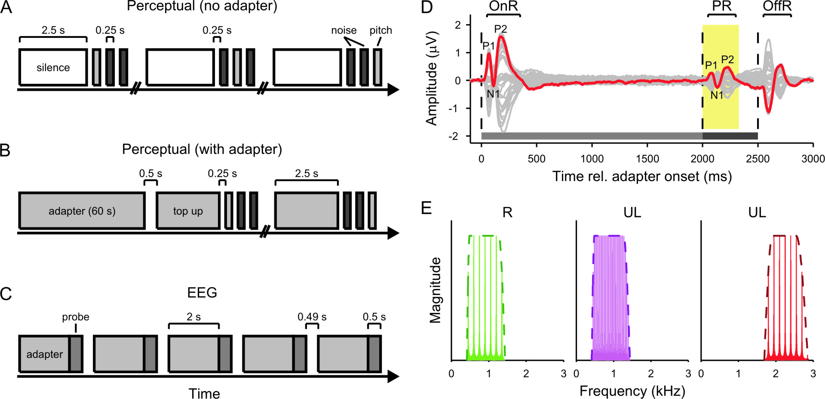
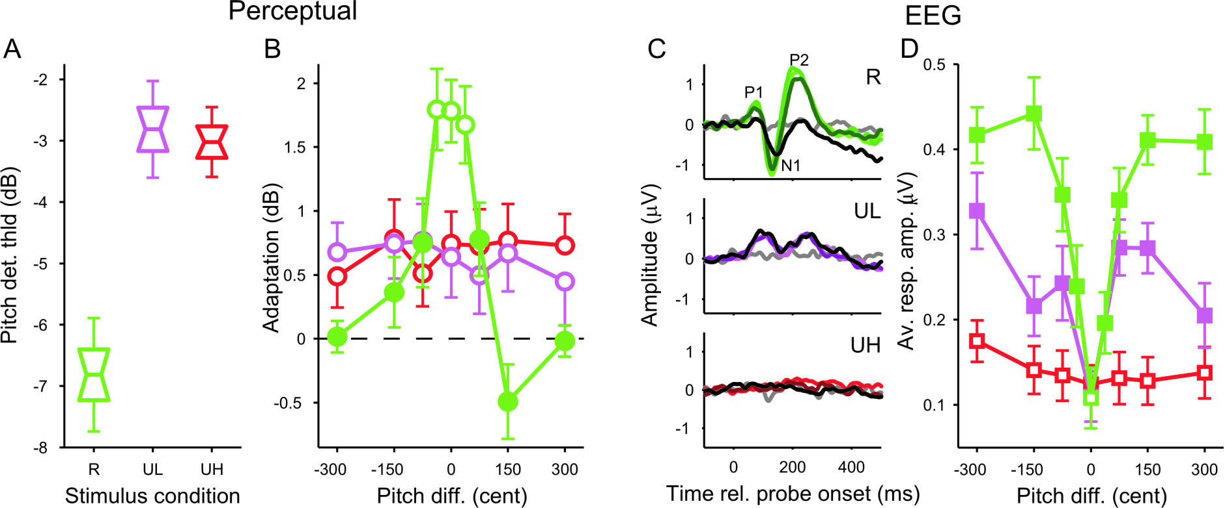
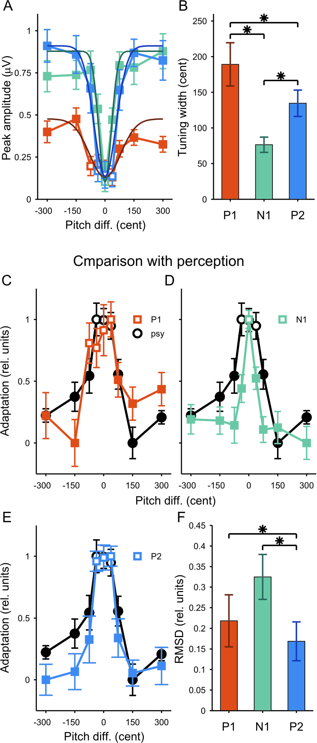
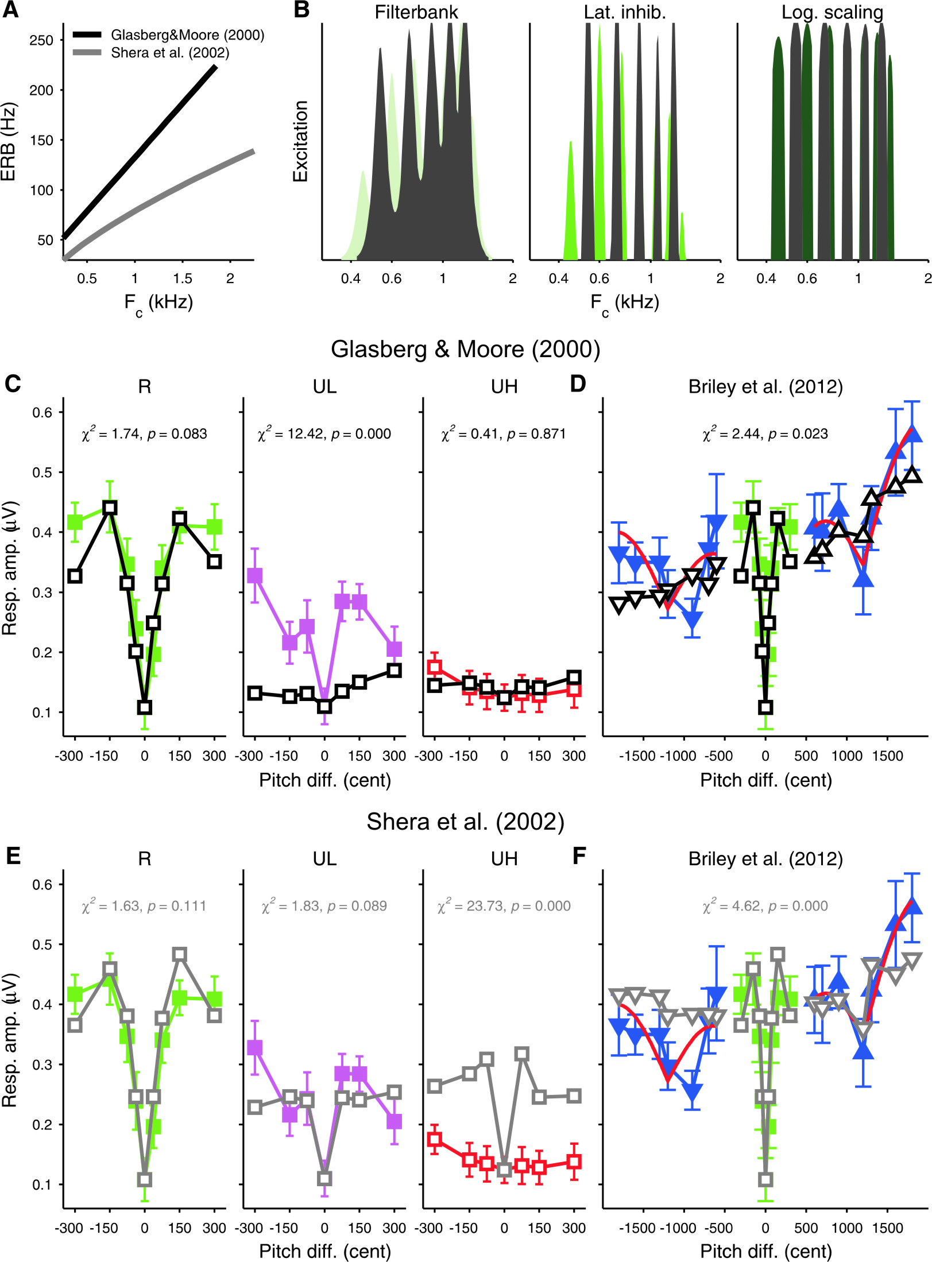
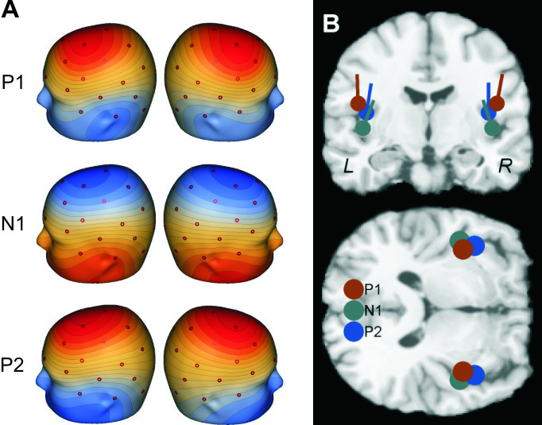
A hierarchy of neural tuning to spectrally resolved pitch in human auditory cortex
Katrin Krumbholz¹, Jamila Andoh^{1,2}, Antje Heinrich¹, Gemma Hutchinson¹, Paul M. Briley¹, Robert J. Zatorre²
¹MRC Institute of Hearing Research, Nottingham, UK,
²Montreal Neurological Institute, Montreal, Canada
Email: katrin@ihr.mrc.ac.uk
Montreal Neurological Institute
Introduction
The ability to perceive pitch is crucial for the experience of music and the understanding of speech, and plays an important role in auditory scene analysis. Most pitch-evoking sounds are composed of harmonic frequency components. Music and speech contain lower-order harmonics. Lower-order harmonics are resolved by the cochlear filters and thus convey spectral information, whereas higher-order harmonics are unresolved. It is often assumed that resolved and unresolved harmonics are processed by different neural mechanisms. Here, we test this assumption using perceptual and EEG adaptation in humans. Adaptation refers to the suppression of the response to a probe by a preceding adapter. Importantly, adaptation is stimulus-specific. The degree of adaptation specificity would be expected to reflect the selectivity of the neuron populations responding to the adapter and probe (Fig. 1). Thus, if resolved and unresolved pitches are processed by different neurons, the degree of adaptation specificity to these pitches might differ.
Fig. 1: When the adapter (orange) and probe (green) activate overlapping neuron populations, adaptation should be strong, when they activate non-overlapping populations, adaptation should be weak.
Materials and Methods
Paradigms: Adaptation was measured both perceptually and with EEG. Perceptually, adaptation causes a reduction in pitch salience (Hall & Soderquist, 1978). Here, it was quantified by measuring the just-detectable pitch salience using a 3-interval, 3-alternative adaptive procedure. Pitch detection thresholds were measured after prolonged exposure to an adapter with a strong pitch (Fig. 2B) or without an adapter (Fig. 2A). In EEG, adaptation causes a reduction in the size of the probe response (Fig. 2D). The adapter and probe were presented without a gap to maximise the adaptation effect (Fig. 2C).
Stimuli: The adapter and probe consisted of iterated rippled noise, which is a type of harmonic sound with a noise-like waveform and adjustable pitch salience (Yost, 1996). The pitch difference between them was varied to measure adaptation specificity. There were three stimulus condition (Fig. 2E). In the resolved (R) condition, the probe had a pitch of 150 Hz and was filtered between harmonics 3-9 (450-1350 Hz). In the unresolved-low (UL) condition, the probe was filtered to the same frequency region, but had a lower pitch of 37.5 Hz so as to contain only harmonics from the 12th upwards. In the unresolved-high (UH) condition, the probe had a pitch of 150 Hz, but was filtered between harmonics 12-18 (1800-2700 Hz).
EEG data acquisition: Auditory-evoked cortical potentials were recorded using 33 Ag-AgCl ring electrodes, placed according to the standard 10-20 arrangement, and filtered between 0.1-35 Hz.
Participants: A total of 21 normally-hearing healthy adults (9 female) took part, 11 in the perceptual experiment and 10 in the EEG experiment.
Fig. 2: (A-C) Perceptual trials without (A) and with adapter (B) and EEG trials (C). (D) Grand-average EEG response across conditions and participants; the probe response is marked in yellow. (E) Resolved (R), unresolved-low (UL) and unresolved-high stimulus conditions.
Results I. Effect of spectral resolution
Results II. P1, N1 and P2 comparison
Results III. Model simulations
In the resolved condition, the functions relating the sizes of the P1, N1 and P2 deflections with the pitch difference differed significantly in width, indicating differences in the degree of adaptation specificity (Fig. 4A, B).
Comparison of the EEG adaptation functions with the perceptual adaptation function (Fig. 4C-E; all normalised) showed that the adaptation function of the P2 was the most similar to the perceptual adaptation function (Fig 4F).
Fig. 3: (A) Unadapted pitch detection thresholds. (B) Perceptual adaptation effect as a function of adapter-probe pitch difference. (C) EEG probe responses. (D) EEG response sizes as a function of pitch difference.
The unadapted pitch detection threshold , which reflect the baseline sensitivity to pitch, was lower in the resolved (R) condition than in the unresolved (UL, UH) conditions (Fig. 3A).
The perceptual adaptation effect was specific to the adapter pitch only in the resolved condition and not in the unresolved conditions (Fig. 3B).
The resolved condition produced the largest EEG probe responses; the unresolved-high condition produced no significant response for any pitch difference (Fig. 3C, D).
In the resolved and unresolved-low conditions, the probe response size increased with increasing adapter-probe pitch difference, indicating that adaptation was specific to the adapter pitch.
Fig. 3C suggests that the degree of adaptation specificity differed among the P1, N1 and P2 deflections (Results II).
Fig. 4: (A) Size of the P1, N1, and P2 deflections as a function of pitch difference. (B) Function half-widths. (C-D) Adaptation function for each deflection superposed on the perceptual adaptation function. (F) Root-mean-square deviations (RMSDs) between the perceptual and EEG adaptation functions.
The scalp topographies of P1, N1 and P2 did not differ significantly. All three deflections appeared to arise from a location just anterior to Heschl’s gyrus.
Fig. 6: (A) Two conflicting models of human frequency selectivity. (B, E) Simulations of the current data. (C, F) Simulations of Briley et al.’s (2012) data, which showd that adaptation depends on pitch chroma.
The EEG data were modelled with two conflicting models of human auditory frequency selectivity proposed by Glasberg & Moore (2000) and Shera et al. (2002; Fig. 6A, B).
Neither model was able to explain the difference between the two resolved condtitions (Fig. 6C, E).
Neither model was able to reproduce the chroma effect for unresolved harmonic tones found by Briley et al. (2012; Fig. 6D, F).
Fig. 5: Scalp topographies (A) and equivalent current dipole models of the P1, N1 and P2 deflections.
Conclusions
The perceptual adaptation effect produced by the resolved, but not the unresolved, stimuli was specific to the adapter pitch. This would seem to suggest that resolved harmonics are processed by a different mechanism than unresolved harmonics.
However, the EEG data suggest that even the unresolved-low stimuli conveyed a limited amount of spectral information. This suggests that the mechanism by which a given stimulus is processed is determined, not by the resolvability of its harmonics, but by the ecological relevance of its pitch (i.e., whether it is within the speech and music range). The availability of temporal fine-structure information may also play a role (compare unresolved-high).
Within the range of speech and music, pitch appears to be coded by neural elements that are selective for pitch.
The degree of neural pitch selectivity appears to change across processing levels. At the level of the P2, neural pitch selectivity seems to corresponds to perceptual pitch selectivity.
On average, the pitch selectivity of the EEG responses for the resolved condition corresponded well with the pitch selectivity predicted by two models based on spectral adaptation. However, spectral adaptation could not explain the difference between the unresolved-low and unresolved-high conditions, or the selectivity for pitch chroma observed by Briley at al. (2012).
Acknowledgements: This work was funded by the MRC intramural program and the ERASMUS Mundus Exchange Grant.

